Slide 1
Text to speech conversion for visually Impaired people
Dsp presentation slide

Slide 2
Text To Speech
A Text-to-speech synthesizer is an application that converts text into spoken word, by analyzing and processing the text using Natural Language Processing (NLP) and then using Digital Signal Processing (DSP) technology to convert this processed text into synthesized speech representation of the text. Here, we developed a useful text-to-speech synthesizer in the form of a simple application that converts inputted text into synthesized speech and reads out to the user . The development of a text to speech synthesizer will be of great help to people with visual impairment and make making through large volume of text easier.

Slide 3
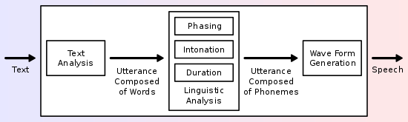
Overview of a typical TTS system

Slide 4
Applications of Text-To-Speech synthesis
telecommunication
multimedia
for individuals with speech impairment
Text-To-Speech systems made it possible to listen to text read by machines, for instance, from a database (instead of human operators). Queries to such databases can be transmitted via user speech (speech recognition systems) or telephone keypad (DTMF systems).
Text-To-Speech synthesis has made possible the existence of talking books, toys and interactive games. Around 2007 for instance, Animo Limited developed a software package which is able to generate narration and lines of dialogue. That software package was developed based on Animo‟s speech synthesis software, FineSpeech .
for individuals with speech impairment, speech synthesis has provided an artificial voice hence simplifying communication with others.

Slide 5
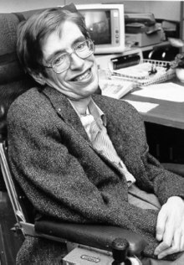
Applications of Text-To-Speech synthesis
The famous physicist Stephen Hawking delivered his lectures using a speech synthesizer

